Slide 1


CEF 440 INTERNET PROGRAMMING (J2EE) AND MOBILE PROGRAMMING TASK 2
FACULTY OF ENGINEERING AND TECHNOLOGY
DEPARTMENT OF COMPUTER ENGINEERING
Instructors : DR. VALERY

Slide 2
Group 15
NO | NAMES | MATRICULE | SPECIALTY
01 | KONGNYUY RAYMOND AFONI | FE21A219 | NE
02 | BESSONG ELIAS ASUMU | FE21A149 | SE
03 | KANKO KAMEDJEU DUPLEX | FE21A210 | NE
04 | KENEDY MALLEY ITUKA | FE21A212 | NE
05 | AZEFACK JUNIOR | FE21A146 | NE

Slide 3
Task2
Requrement Gathering

Slide 4
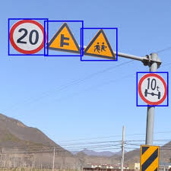
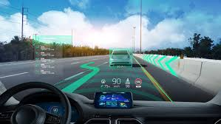
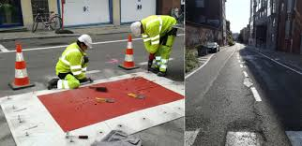
1. Proposed features
Priority Features
Sign Detection
Real-Time Road Sign Information
Road Condition Updates
Using Vienna convention dataset
Real time sign information
Traffic, accidents and weather

Slide 5
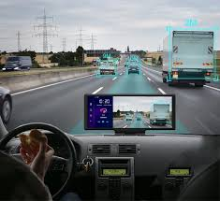
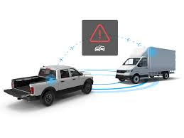
Optional Features
Augmented Reality Navigation
Crash Detection
utilize computer vision to detect car crashes
With lane detection

Slide 6



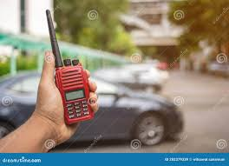
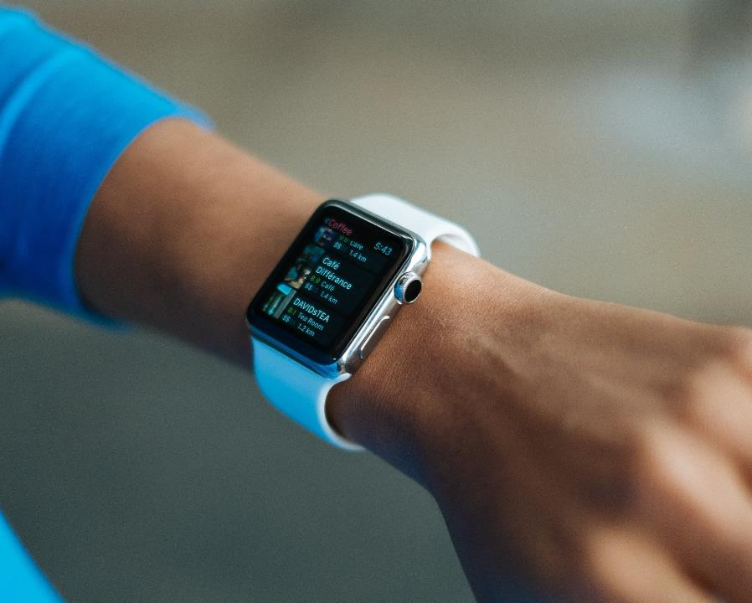

2: Importance Of Requirement Gathering
Reducing Development Risks
Improve user satisfaction
Defining Project Scope
Facilitate communication
Facilitates Testing and Validation

Slide 7
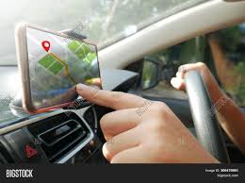
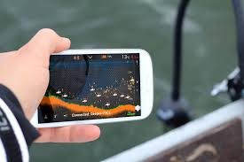
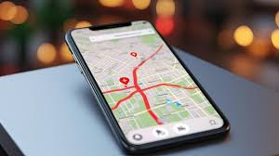
3.Why Requirement Gathering is Crucial
Understand Drivers Needs
Ensure road safety
Through interview and surveys
Prioritize critical information
Integrate existing data
Traffic data,weather services
Develop a user-friendly interface

Slide 8
4. Requirement Gathering Techniques
Stakeholder Identification
Users Needs Elicitation
Target users
Transportation Authorities
User interview
User review(of similar apps)
Potentials partners
Surveys

Slide 9
5. Functional and non-functional requirements
Functional requirements
Swift (Native)
Real time road sign recognition
Location-aware information and navigation
Traffic light and signdetection
User reporting
User profile

Slide 10
Non-Functional requirements
Reliability(accurate info and minimal interruption
Performance(real-time processing, high detection accuracy
Usability(broad user accessibility)
Maintainability and security
Security and privacy(data protection and encryption)

Slide 11
Additional consideration
Battery consumption
Offline Functionality

Slide 12


Thank You
GROUP 15
GitHub - Asumu22/group-15

